Slide 1

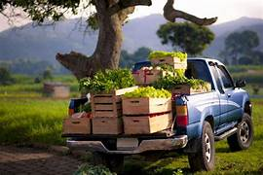
TrANSPORTATION SYSTEM FOR FARMERS:
Presented By:
Prathamesh Shinde
Onkar Wavhal
Pooja Salgar
Adinath Kadam

Slide 2

Overview :
Introduction
Aim of Project
Purpose and Solution
ER – Diagram
Software Used for Development
Overview of the software and Frameworks used
Future Upgradation
Conclusion

Slide 3
INTRODUCTION:
The main purpose of our transportation system is to provide transportation service to the farmers and merchants. After the data has been fed into the database, Our role is to provide vehicle for transport of goods and seeds of farmers and merchants.

Slide 4
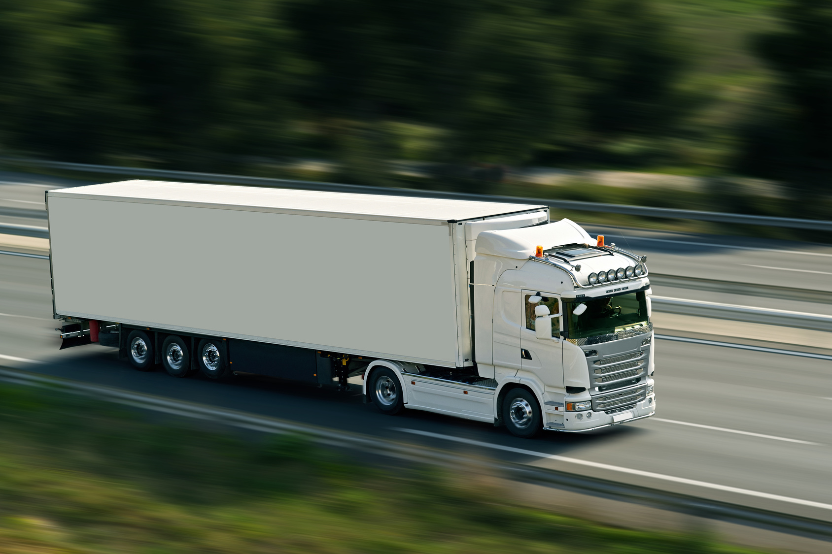
Aim of Project :
As in the modern era we all know that there are many issues related to the transportation services for farmers to carry their goods from farm to market.
So our project is based on the same concept of providing transportation service to the farmers and merchants

Slide 5
Purpose :
As we have seen that in Rular area farmers and merchants faces many Issues related to the transportation services at time of carrying their goods from rular to market area
We have designed an website through which the farmer and merchant request for the transport service and then we provide transport service to them.
SOLUTION :

Slide 6
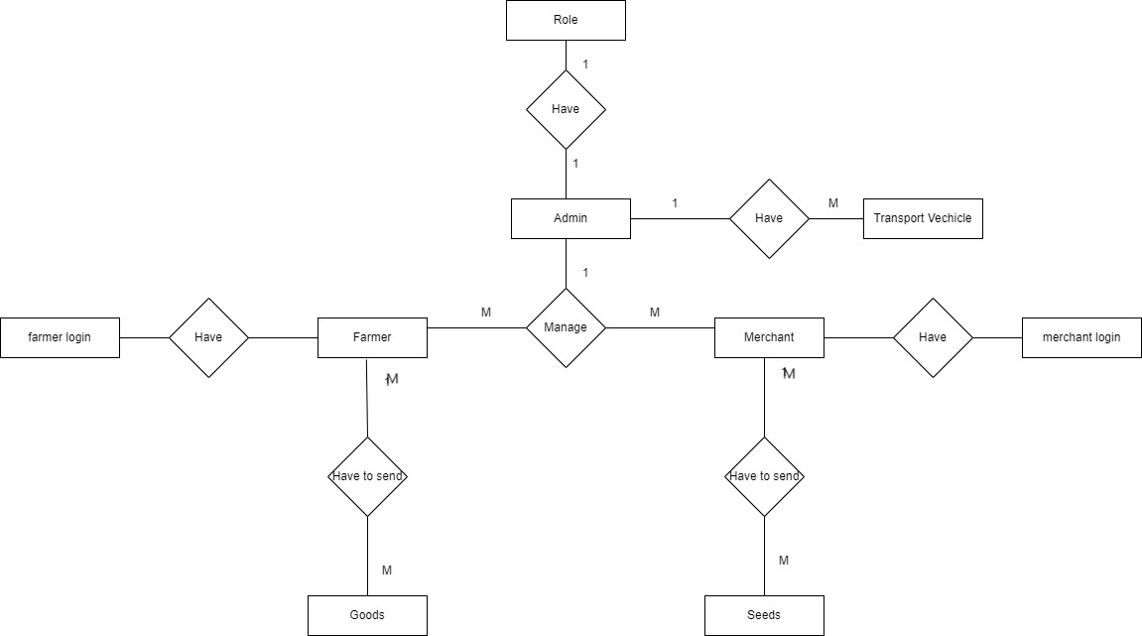
ER – Diagram :

Slide 7
Software frameworks :
Back – end software
Front – end software
My – SQL
JPA
Spring boot
Postman
Angular JS:
HTML
CSS
JAVASCRIPT
TYPESCRIPT
BOOTSTRAP

Slide 8
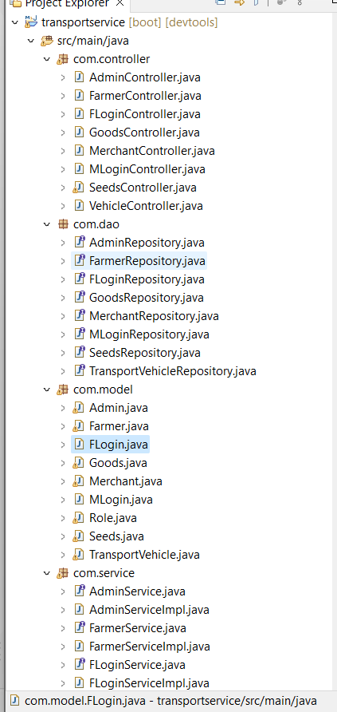
Back – end development:
1) Encapsulation ( Single unit processing)
2 ) Abstraction
( hiding implementation and showing the functionality)

Slide 9
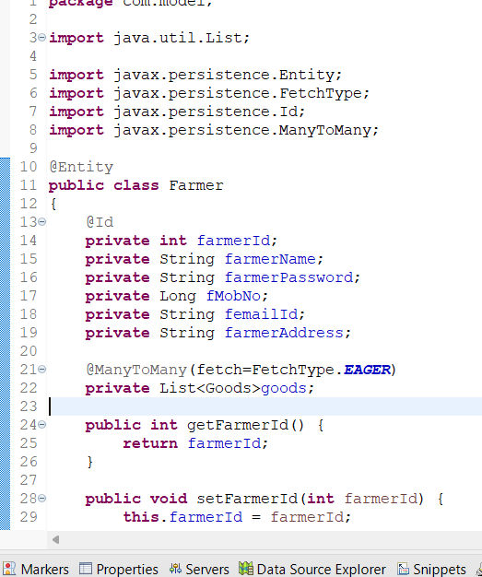
Jpa – ( Mappings)
It is the mapping concept of the JPA specification due to which the Entity ( POJO ) classes are mapped with each other.
Without mapping project is not completed as there is no relation between the Entities

Slide 10
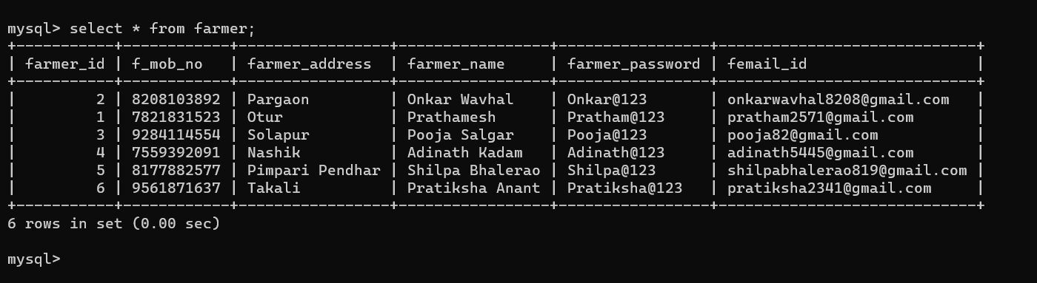
MY – SQL ( DATABASE ) :
As the mapping is completed it can be it is shown that how the data from frontend can be fetch in MySql database.

Slide 11
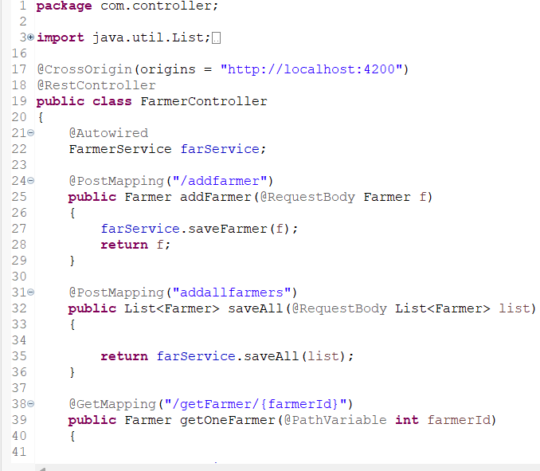
Spring boot framework
ANGULAR JS connectivity :
For connecting the back – end logic with the front – end webpage
POSTMAN (testing client) :
Postman data insertion but using the mapping annotations

Slide 12
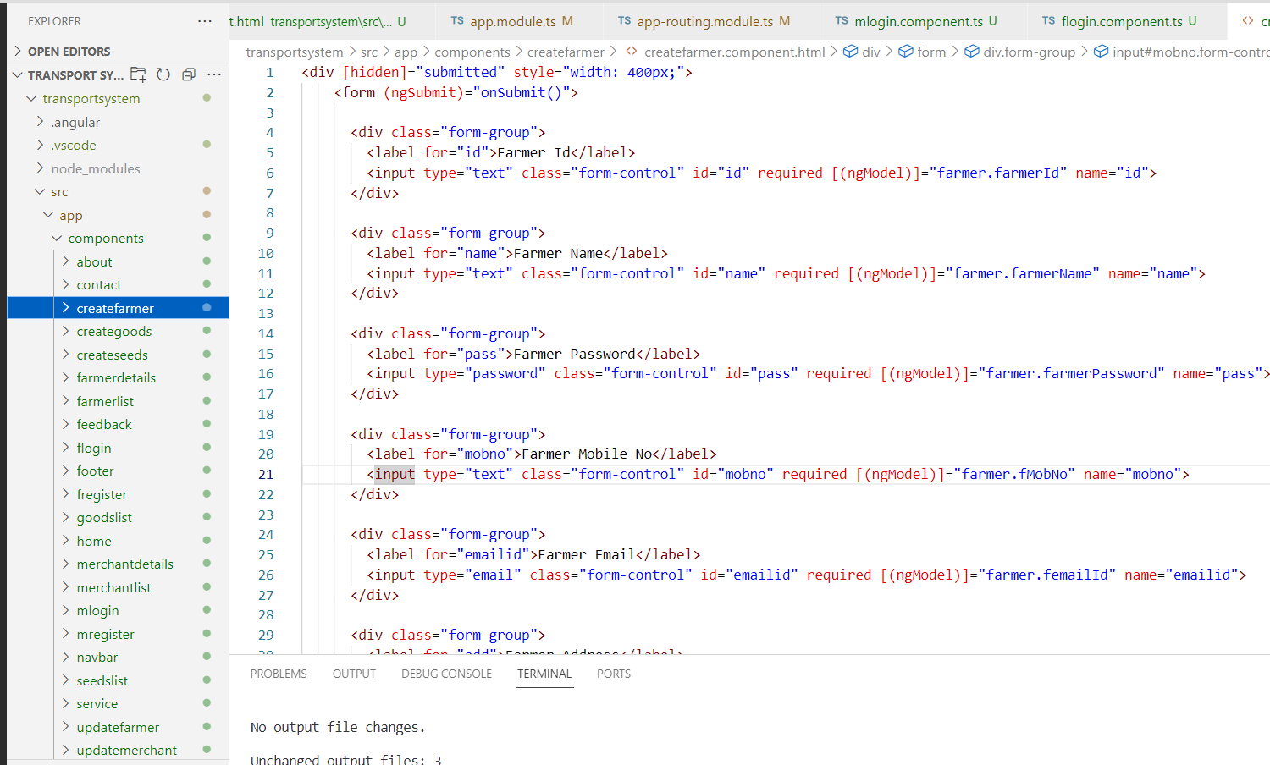
Angular Js :
It is the front – end development for making a single page application with the connectivity between the farmer and the back – end software to communicate with each other .
Components of angular

Slide 13
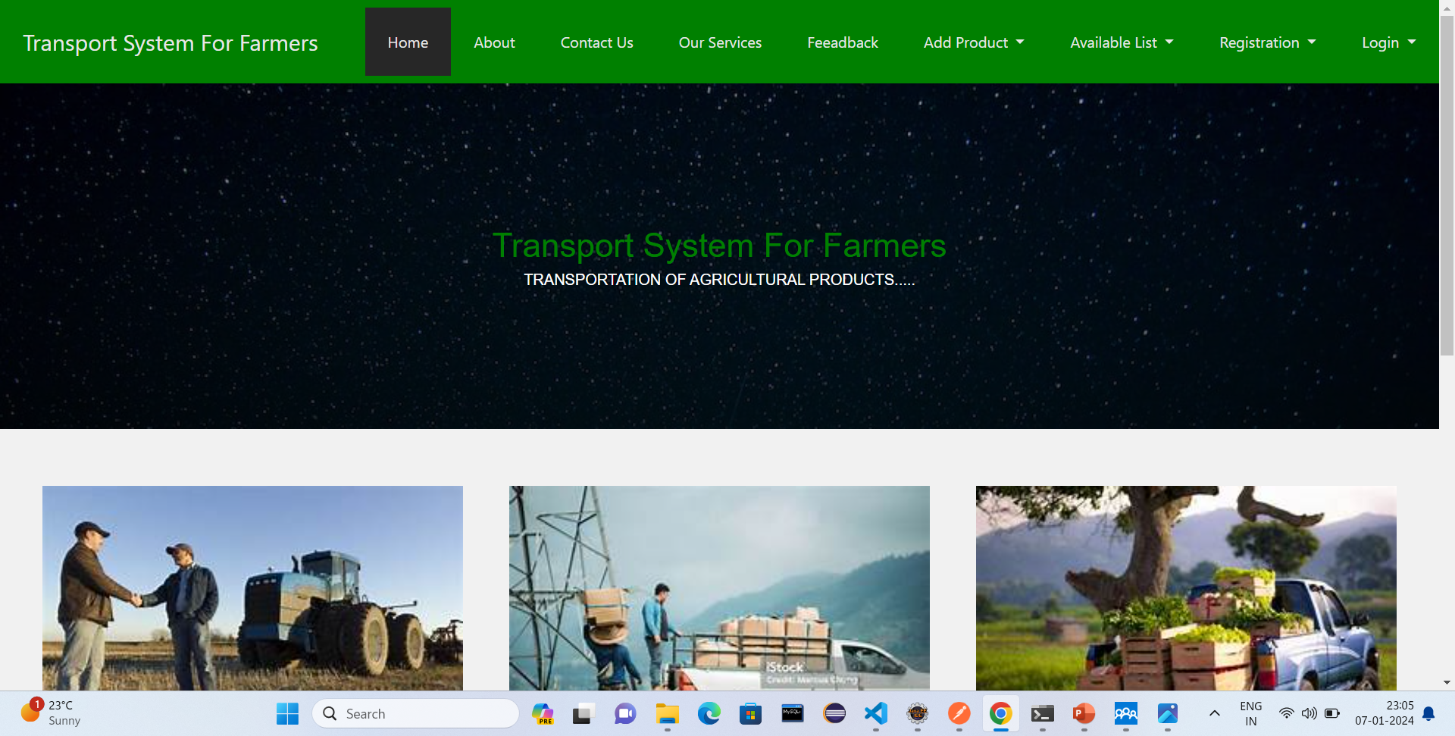
Front – Page of Website ( ANGULAR – JS ) :
Home Page:

Slide 14
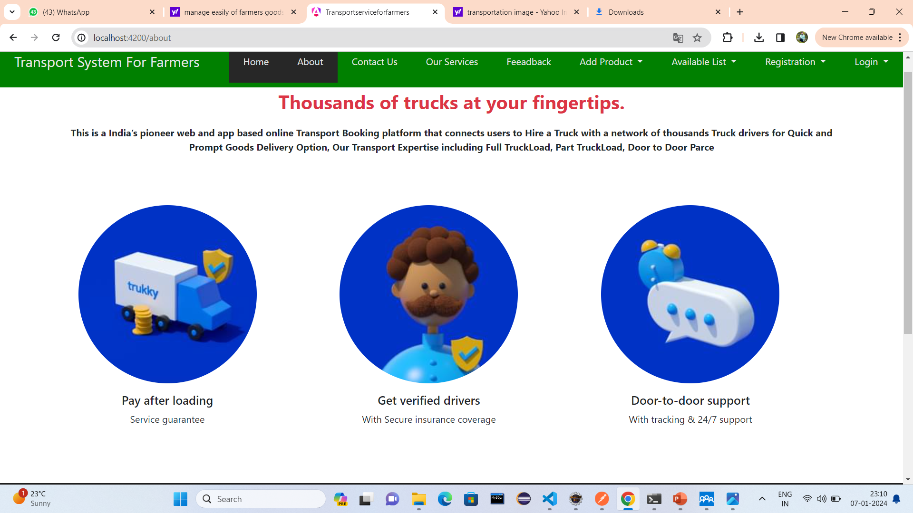
About page:

Slide 15
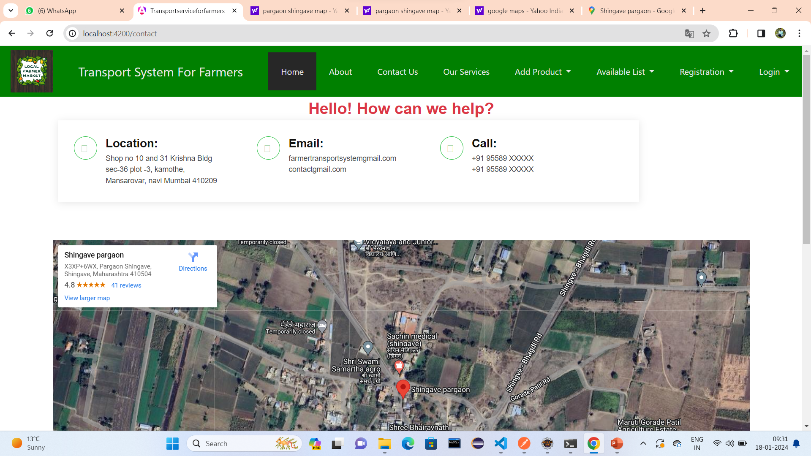
Contact Us page:

Slide 16
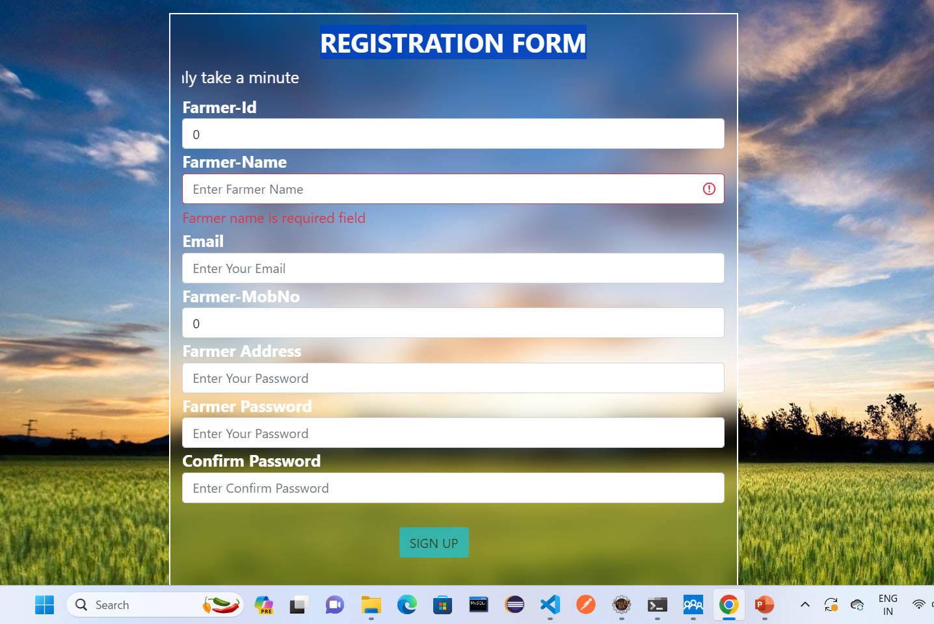
Farmer Registration:

Slide 17
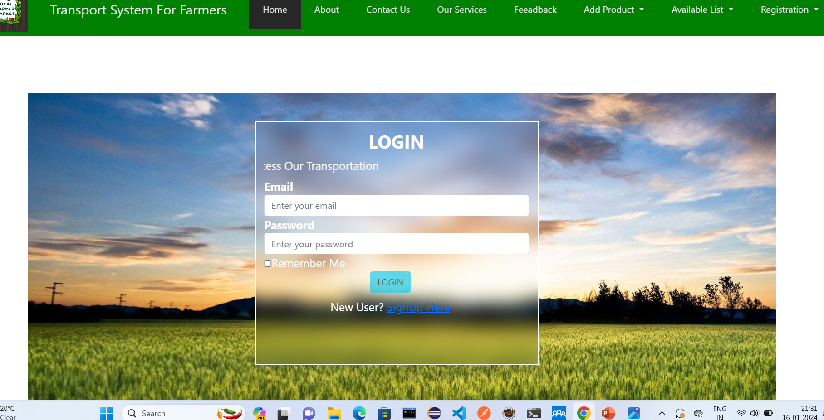
Farmer Login:

Slide 18
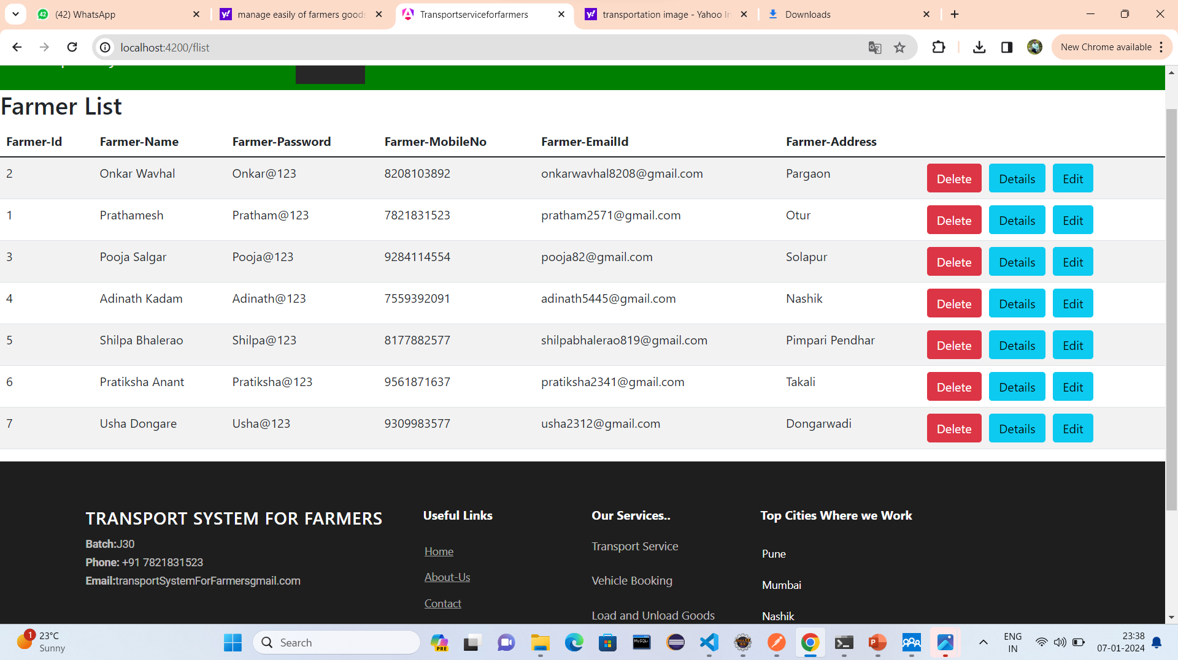
Farmer List:

Slide 19
Future Updates :
Text Message updates
QR Code for Payment.
Real Time Tracking
Email Updates

Slide 20
conclusion :
In conclusion, the Transportation project aims to provide Transportation service to the farmers and merchants. By providing transportation service to the farmers and merchants we pickup their goods and seeds from pickup location and delivered to delivery Locations.
…THANK YOU

